Slide 1
FORMAL LANGUAGES AND AUTOMATION THEORY
Lecture #2

Slide 2
Input alphabet (Diagram Based)
Notes:
Input alphabet

Slide 3
Cont.
Set of States
Notes:
Set of States

Slide 4
Initial State
Notes:
Initial State

Slide 5
Set of Accepting States
Accepting State
Notes:
Accepting State

Slide 6
Example
Input String

Slide 7
Reading the Input

Slide 11
Input finished
accept

Slide 12
Rejection

Slide 16
Input finished
reject

Slide 17
Class Work
abbbaaab
bababaa
abbaaba

Slide 18
MCQ
Which of the following is not a part of 5-tuple finite automata? a) Input alphabet b) Transition function c) Initial State d) Output Alphabet
Notes:
d

Slide 19
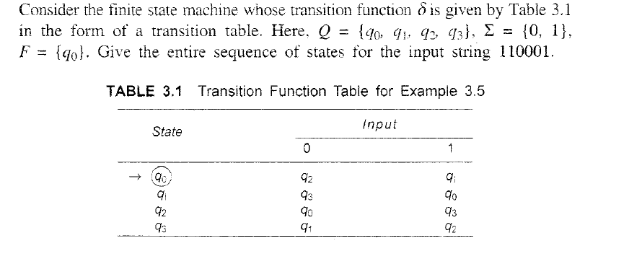
Example Table Form

Slide 20
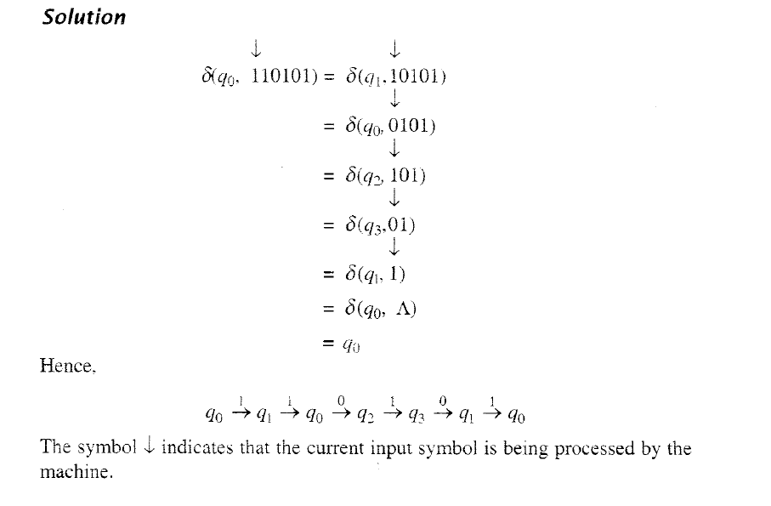
Cont.

Slide 21
Class Work
Check for the 101101
11111
000000

Slide 22
DFA VS NFA
Sr. No. | DFA | NFA
1 | DFA stands for Deterministic Finite Automata. | NFA stands for Nondeterministic Finite Automata.
2 | For each symbolic representation of the alphabet, there is only one state transition in DFA. | No need to specify how does the NFA react according to some symbol.
3 | DFA can be understood as one machine. | NFA can be understood as multiple little machines computing at the same time.
4 | DFA is more difficult to construct. | NFA is easier to construct.
5 | Time needed for executing an input string is less. | Time needed for executing an input string is more.
6 | All DFA are NFA. | Not all NFA are DFA.
7 | Epsilon move is not allowed in DFA | Epsilon move is allowed in NFA
8 | DFA allows only one move for single input alphabet. | There can be choice (more than one move) for single input alphabet.

Slide 23
Examples
DFA

Slide 24
Example
DFA Description:
States: Q = {q0, q1}
Alphabet: Σ = {0, 1}
Transitions:
δ(q0, 0) = q0
δ(q0, 1) = q1
δ(q1, 0) = q1
δ(q1, 1) = q0
Start State: q0
Accept States: {q1}
Question: Does the DFA accept the string "010"?

Slide 25
Answer
The DFA processes "010" as follows:
Start at q0.
Read '0', transition to q0.
Read '1', transition to q1.
Read '0', transition to q1. The DFA ends in state q1, which is not an accept state, so it does accept "010".

Slide 26
Diagram
0 | 1 | 0
0
0
1
q0
q1
1

Slide 27
Diagram
0 | 1 | 0
0
0
1
q0
q1
1

Slide 28
Diagram
0 | 1 | 0
0
0
1
q0
q1
1

Slide 29
Diagram
0 | 1 | 0
0
0
1
q0
q1
1
Accepted

Slide 30
Example
DFA Description:
States: Q = {q0, q1}
Alphabet: Σ = {a, b}
Transitions:
δ(q0, a) = q1
δ(q0, b) = q0
δ(q1, a) = q1
δ(q1, b) = q0
Start State: q0
Accept States: {q1}
Question: Does the DFA accept the string "ab"?

Slide 31
Answer
The DFA processes "ab" as follows:
Start at q0.
Read 'a', transition to q1.
Read 'b', transition to q0. The DFA ends in state q0, which is not an accept state, so it does not accept "ab".

Slide 32
Example
DFA Description:
States: Q = {q0, q1, q2}
Alphabet: Σ = {0, 1}
Transitions:
δ(q0, 0) = q1
δ(q0, 1) = q0
δ(q1, 0) = q2
δ(q1, 1) = q0
δ(q2, 0) = q2
δ(q2, 1) = q2
Start State: q0
Accept States: {q2}
Question: Does the DFA accept the string "0010"?

Slide 33
Answer
Yes. The DFA processes "0010" as follows:
Start at q0.
Read '0', transition to q1.
Read '0', transition to q2.
Read '1', transition to q2.
Read '0', transition to q2. The DFA ends in state q2, which is an accept state, so it accepts "0010".

Slide 34
Example
DFA Description:
States: Q = {q0, q1, q2}
Alphabet: Σ = {a, b}
Transitions:
δ(q0, a) = q1
δ(q0, b) = q0
δ(q1, a) = q0
δ(q1, b) = q2
δ(q2, a) = q2
δ(q2, b) = q2
Start State: q0
Accept States: {q2}
Question: Does the DFA accept the string "abab"?

Slide 35
Answer
Yes. The DFA processes "abab" as follows:
Start at q0.
Read 'a', transition to q1.
Read 'b', transition to q2.
Read 'a', transition to q2.
Read 'b', transition to q2. The DFA ends in state q2, which is an accept state, so it accepts "abab".

Slide 36
Example
DFA Description:
States: Q = {q0, q1, q2, q3}
Alphabet: Σ = {0, 1}
Transitions:
δ(q0, 0) = q1
δ(q0, 1) = q2
δ(q1, 0) = q3
δ(q1, 1) = q0
δ(q2, 0) = q0
δ(q2, 1) = q3
δ(q3, 0) = q2
δ(q3, 1) = q1
Answer: No. The DFA processes "1100" as follows:
Start at q0.
Read '1', transition to q2.
Read '1', transition to q3.
Read '0', transition to q2.
Read '0', transition to q0. The DFA ends in state q0, which is an accept state, so it accepts "1100".

Slide 37
Cont.
Start State: q0
Accept States: {q0}
Question: Does the DFA accept the string "1100"?

Slide 38
Answer
No. The DFA processes "1100" as follows:
Start at q0.
Read '1', transition to q2.
Read '1', transition to q3.
Read '0', transition to q2.
Read '0', transition to q0. The DFA ends in state q0, which is an accept state, so it accepts "1100".

Slide 39
Examples
NFA/NDFA

Slide 40
Nondeterministic Finite Automaton
Alphabet =

Slide 41
Alphabet =
Two choices

Slide 42
Alphabet =
Two choices
No transition
No transition

Slide 43
First Choice

Slide 44
First Choice

Slide 45
First Choice

Slide 46
First Choice
All input is consumed
“accept”

Slide 47
Second Choice

Slide 48
Second Choice

Slide 49
Second Choice
No transition:
the automaton hangs

Slide 50
Second Choice
Input cannot be consumed
“reject”

Slide 51
Example
is accepted by the NFA:
“accept”
“reject”
because this
computation
accepts

Slide 52
Rejection example

Slide 53
First Choice

Slide 54
First Choice
“reject”

Slide 55
Second Choice

Slide 56
Second Choice

Slide 57
Second Choice
“reject”

Slide 58
Example
is rejected by the NFA:
“reject”
“reject”
All possible computations lead to rejection

Slide 59
Rejection example

Slide 60
First Choice

Slide 61
First Choice
No transition:
the automaton hangs

Slide 62
First Choice
Input cannot be consumed
“reject”

Slide 63
Second Choice

Slide 64
Second Choice

Slide 65
Second Choice
No transition:
the automaton hangs

Slide 66
Second Choice
Input cannot be consumed
“reject”

Slide 67
is rejected by the NFA:
“reject”
“reject”
All possible computations lead to rejection

Slide 68
Language accepted:

Slide 69
Lambda Transitions

Slide 72
(read head does not move)

Slide 74
all input is consumed
“accept”
String is accepted

Slide 75
Rejection Example

Slide 77
(read head doesn’t move)

Slide 78
No transition:
the automaton hangs

Slide 79
Input cannot be consumed
“reject”
String is rejected

Slide 80
Language accepted:

Slide 81
Another NFA Example

Slide 85
“accept”

Slide 86
Another String

Slide 93
“accept”

Slide 94
Language accepted

Slide 95
Example
NFA Description:
States: Q = {q0, q1, q2}
Alphabet: Σ = {a, b}
Transitions:
δ(q0, a) = {q1, q2}
δ(q0, b) = {q0}
δ(q1, a) = {q1}
δ(q1, b) = {q0, q2}
δ(q2, a) = ∅
δ(q2, b) = {q2}
Start State: q0
Accept States: {q2}
Question: Does the NFA accept the string "aab"?

Slide 96
Example
NFA Description:
States: Q = {q0, q1, q2}
Alphabet: Σ = {a, b}
Transitions:
δ(q0, a) = {q0, q1}
δ(q0, b) = {q2}
δ(q1, a) = {q2}
δ(q1, b) = ∅
δ(q2, a) = {q2}
δ(q2, b) = {q1}
Start State: q0
Accept States: {q2}
Question: Does the NFA accept the string "baa"?

Slide 97
Example
NFA Description:
States: Q = {q0, q1, q2, q3}
Alphabet: Σ = {a, b}
Transitions:
δ(q0, a) = {q1}
δ(q0, b) = {q0, q2}
δ(q1, a) = {q3}
δ(q1, b) = {q1}
δ(q2, a) = ∅
δ(q2, b) = {q3}
δ(q3, a) = {q3}
δ(q3, b) = ∅
Start State: q0
Accept States: {q3}
Question: Does the NFA accept the string "abbb"?

Slide 98
Example
NFA Description:
States: Q = {q0, q1, q2, q3}
Alphabet: Σ = {a, b}
Transitions:
δ(q0, a) = {q0, q1}
δ(q0, b) = {q2}
δ(q1, a) = {q3}
δ(q1, b) = {q1, q2}
δ(q2, a) = {q1}
δ(q2, b) = {q3}
δ(q3, a) = {q0}
δ(q3, b) = ∅
Start State: q0
Accept States: {q3}
Question: Does the NFA accept the string "abb"?

Slide 99
Example
NFA Description:
States: Q = {q0, q1, q2}
Alphabet: Σ = {a, b}
Transitions:
δ(q0, a) = {q1}
δ(q0, b) = {q2}
δ(q1, a) = {q0, q1}
δ(q1, b) = {q2}
δ(q2, a) = ∅
δ(q2, b) = {q1, q2}
Start State: q0
Accept States: {q1}
Question: Does the NFA accept the string "aab"?

Slide 100
Minimization of DFA
Minimization of DFA means reducing the number of states from given FA.
Thus, we get the FSM(finite state machine) with redundant states after minimizing the FSM.
DFA minimization stands for converting a given DFA to its equivalent DFA with minimum number of states.
DFA minimization is also called as Optimization of DFA and uses partitioning algorithm.

Slide 101
Example
DFA Minimization
a
a
q0
q1
q3
a
b
b
a
b
q2
q4
a
b
b
b
a
q6
q5
b
a

Slide 102
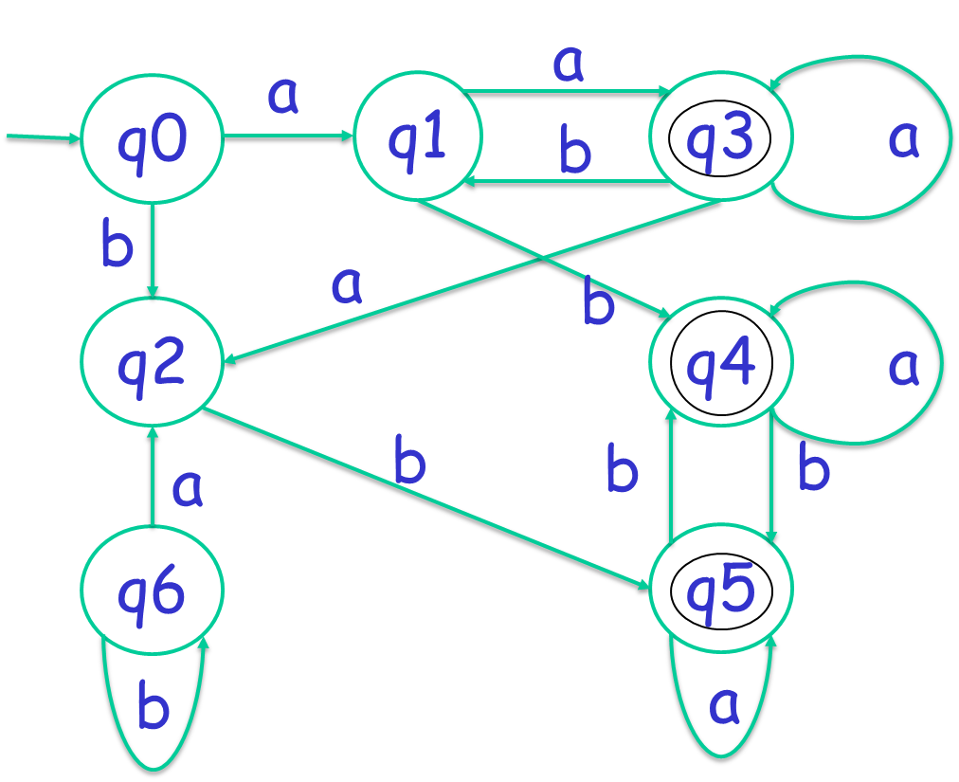
Cont.
State | a | b
q0 | q1 | q2
q1 | q3 | q4
q2 | q3 | q5
q3 | q3 | q1
q4 | q4 | q5
q5 | q5 | q4
q6 | q2 | q6

Slide 103
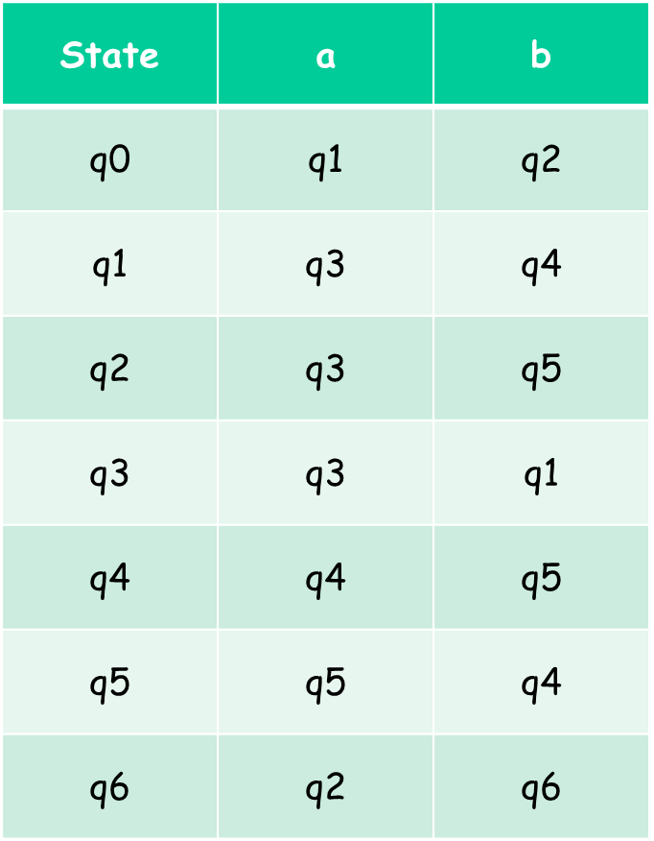

Cont.
Transition Table
Minimization
Remove unreachable state from initial state.
q6 is unreachable state from initial state qo.
Therefor, q6 eliminated from the DFA.

Slide 104
Cont.
Transition Table
Minimization
Now convert all state in equivalent group.
One group will be final states and another one will be non-final states.
G1 : {q0,q1,q2} & G2: {q3,q4,q5}
G11:{q0} G12: {q1,q2} & G21:{q3} G22: {q4,q5}
G111:{q0} G112: {q1,q2} & G211:{q3} G212: {q4,q5}
So, at the end, we minimized DFA (From 7 states to 4 states).

Slide 105
Cont.
Minimized DFA
a
q0
q3
a
a,b
b
a,b
q1q2
b
q4q5

Slide 106
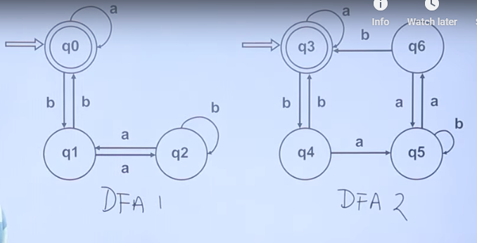
Condition to check
Equivalent DFA
Is initial state and final state same in both?
Later check all state in both, weather have IS-IS relationship or FS-FS relationship?
IS= Intermediate state
FS= Final State
State | a | b
q0q3 | q0q3 | q1q4
 | FS - FS | IS - IS

Slide 107
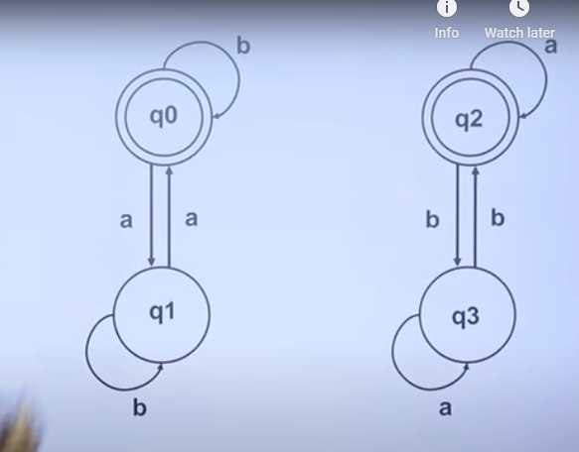
Example

Slide 108

Any Question??

